Slide 1
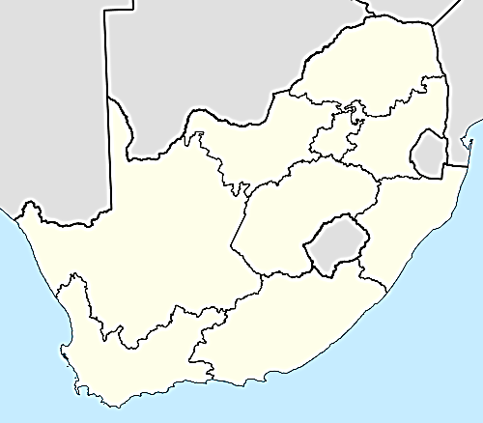
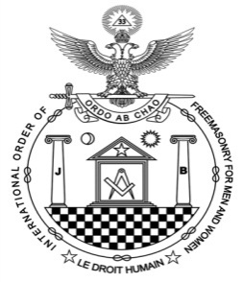

KEY
LODGES IN 1931
Triangle
Craft Lodge
York Lodge
Sov. Chapter
Encampment
Notes:
There was great growth in the Lodges
Was it the principles of brotherhood, relief, charity or the need for stability and the sense of belonging that drew people into masonry?
Dawn Lodge was Consecrated on 13 july 1922.
1st RWM Bro A Cook
Regretfully a discordant element crept into the lodge. Due to unacceptable behaviour and actions of certain BB and SS the Lodge was closed down by the Admin General
Illus Bro M de Graaf stated that the due to the relaxation in the screening of candidates and discordant element crept into Dawn lodge. Due to unacceptable behaviour and actions of certain BB and SS the Lodge was closed down by the Admin General 0n 13 July 1950
This was a great pity because this was a very active Lodge with a large membership
Isis Hathor Lodge no 228 was consecrated on Saturday 23 Sept 1923 with 9 Founding members in the Orient of PMB 228 Church Street PMB
1 st RWM Sister Violet Puzey ( of the first initiate of Amity Lodge)
As a young mason in Isis Hathor Lodge, I recall the companionship of dragging out the furniture and setting up the Lodge in the Odd Fellows Hall. Even the Illus Sister Laura Ford 32 ° then in her 80’s, assisted. Afterwards the furniture has to be put away. Even the cups had to be washed ,packed into boxes for RW bro Ensle Syphus to take home. I also recall the cold winter meetings sitting as the OG literally outside in the cold winters of PMB.
How moved I was going through the archives to come across a letter I wrote to my Mother (RWBro Syphus) on her installation. How the written word can bring back such memories. Such a pity that brethren no longer take the time to write to inspire other brethren.
Illus BroP A Peal 32 was the prime mover for the creation of the 12th triangle in Germiston. He furnished the Lodge and loaned money for its foundation. The first mtg was on 8 dec 1929 and was consecrated as a lodge with 8 founding members on 3 May 1930. Lodge named Lodge Lifgt of Osiris no 232.
Motto: Let the light shine
This lodge went into abeyance on 22 March 1993. Brethren know I am very keen for this lodge to be resuscitated and to work on the weekend.
It now became possible to build on the foundation of stable craft Lodges .
Briefly other lodges created were:
Natal Mark Lodge no 5 1921 DBN
Sovereign Chapter Veritas no 31 1921 DBN
Unity Mark – CT 1924

Slide 2



Sovereign Chapter Amor no 102
Consecrated on 27 March 1938 in Valley of Johannesburg
Sovereign Chapter Good Hope no 98,
formed as thirteenth triangle on 217 September 1936 and
Consecrated on 17 October 1937.
Surrendered Charter in 1949 but resuscitated on 29 October 1978
Holy Royal Arch Ithurial no 33
Consecrated on 1 January 1940. Still active in the vault of Johannesburg
Royal Ark Marineers moored to TVL Mark Lodge no 27
Consecrated on 10 April 1949 by 10 founding members. Went into abeyance on 21 February 1994 but resuscitated on 9 August 2010
Encampment of the Southern Light no 127
Consecrated in the camp of Durban on 29 April 1949.
Charter moved to Cape town on 25 September 2011
Association of Installed Masters formed in Durban & Johannesburg in 1949

Slide 3



lodge Light of Africa no 233 Consecrated on 24 April 1949
with 7 Founder members. In Orient of Durban. Still active
Lodge Renaissance no 234, Orient Cape Town
Triangle formed on 23 March 1949, consecrated on
10 October 1949, All Cape town Lodges closed down on 13 July 1950.
Orpheus lodge ( no Number) Orient Cape Town, provincial warrant 4 September 1948 but returned on 24 February 1949
Sun in Splendor no 235 – Bulawayo, Rhodesia, 1 March 1952. Due to distance was closed down in 1954
Athena Lodge no 236 – Orient Pretoria, consecrated as a
study Lodge on 4 April 1952. Still active as a lodge
Masonic Light no 237 – Orient Durban also consecrated as a study Lodge on 20 October 1952. Went into abeyance in 1993.
Lodge Dedication no 238 – Orient Cape Town, consecrated on
16 April 1956. Still active.
Lodge Harmonia no 239 Orient Johannesburg, consecrated on 17 March 1956 – Used the Verulam Ritual. Closed by Consistory on 19 April 1961
Lodge Fraternity no 240, Orient Durban, consecrated on
19 May 1960, Used the Verulam Ritual. Now working as a triangle.

Slide 4
Natal Lodge of Royal Ark Marineers moored to Natal Mark Lodge no 5, consecrated on 21 April 1952. Went into Abeyance in November 2002.
Mark Lodge of the Mystic Arch no 42, consecrated
on 20 February 1957, Quarries of Durban, using the Sydney ritual
Khurum Mark Lodge no 43, Quarries of Pretoria, consecrated
on 4 October 1957. Went into abeyance 2002
Sovereign Chapter no 117 , Valley of Pietermaritzburg, Consecrated 29 June1958. Charter returned 25 November 1989.
Khurum Lodge of Royal Ark Marineers moored to
Khurum Mark Lodge no 43, consecrated on 6 April 1963. Went into abeyance 2002
Encampment of the Mystic Quest no 138, Camp of Johannesburg, consecrated on 18 April 1989. Still active
Good Hope Mark triangle, Quarries of Cape Town , formed on
16 April 1967. Provisional warrant returned on 27 October 1978 and a full lodge consecrated on 27 October 1978. Mark Bro M Raymond is the only surviving founder member.( 2014)

Slide 5
KEY
Triangle
LODGES IN 1967
Craft Lodge
York Lodge
Sov. Chapter
Encampment
Notes:
There was great growth in the Lodges
Was it the principles of brotherhood, relief, charity or the need for stability and the sense of belonging that drew people into masonry?
Dawn Lodge was Consecrated on 13 july 1922.
1st RWM Bro A Cook
Regretfully a discordant element crept into the lodge. Due to unacceptable behaviour and actions of certain BB and SS the Lodge was closed down by the Admin General
Illus Bro M de Graaf stated that the due to the relaxation in the screening of candidates and discordant element crept into Dawn lodge. Due to unacceptable behaviour and actions of certain BB and SS the Lodge was closed down by the Admin General 0n 13 July 1950
This was a great pity because this was a very active Lodge with a large membership
Isis Hathor Lodge no 228 was consecrated on Saturday 23 Sept 1923 with 9 Founding members in the Orient of PMB 228 Church Street PMB
1 st RWM Sister Violet Puzey ( of the first initiate of Amity Lodge)
As a young mason in Isis Hathor Lodge, I recall the companionship of dragging out the furniture and setting up the Lodge in the Odd Fellows Hall. Even the Illus Sister Laura Ford 32 ° then in her 80’s, assisted. Afterwards the furniture has to be put away. Even the cups had to be washed ,packed into boxes for RW bro Ensle Syphus to take home. I also recall the cold winter meetings sitting as the OG literally outside in the cold winters of PMB.
How moved I was going through the archives to come across a letter I wrote to my Mother (RWBro Syphus) on her installation. How the written word can bring back such memories. Such a pity that brethren no longer take the time to write to inspire other brethren.
Illus BroP A Peal 32 was the prime mover for the creation of the 12th triangle in Germiston. He furnished the Lodge and loaned money for its foundation. The first mtg was on 8 dec 1929 and was consecrated as a lodge with 8 founding members on 3 May 1930. Lodge named Lodge Lifgt of Osiris no 232.
Motto: Let the light shine
This lodge went into abeyance on 22 March 1993. Brethren know I am very keen for this lodge to be resuscitated and to work on the weekend.
It now became possible to build on the foundation of stable craft Lodges .
Briefly other lodges created were:
Natal Mark Lodge no 5 1921 DBN
Sovereign Chapter Veritas no 31 1921 DBN
Unity Mark – CT 1924

